Slide 1

Tutorial: Optimization Model
Forestry Biofuels Statewide Collaboration Center

Slide 2
Overview
Introduction
Spreadsheet Key
Data Input Screens
  Cost, Energy, Emissions
  Feedstocks – Federal, State, Private
Availability, Residue, Roundwood, Adjustments
Biorefinery Size and Conversion Rate
Rectilinear Distance
Calculated Cells – Cost, Energy, Emissions
Model Output – Single
Data Input – Multi Location
Model Output – Multi Location

Slide 3
Introduction
Optimization Model
Inputs
Calculations
Results
Limitations

Slide 4

Spreadsheet Key
The spreadsheet key indicates:
Input Cells
Calculated Cells
Model Results

Slide 5
Data Input Screens –
Cost, Energy, Emissions
Data Entry in the Master Input tab for costs, energy, and emissions

Slide 6
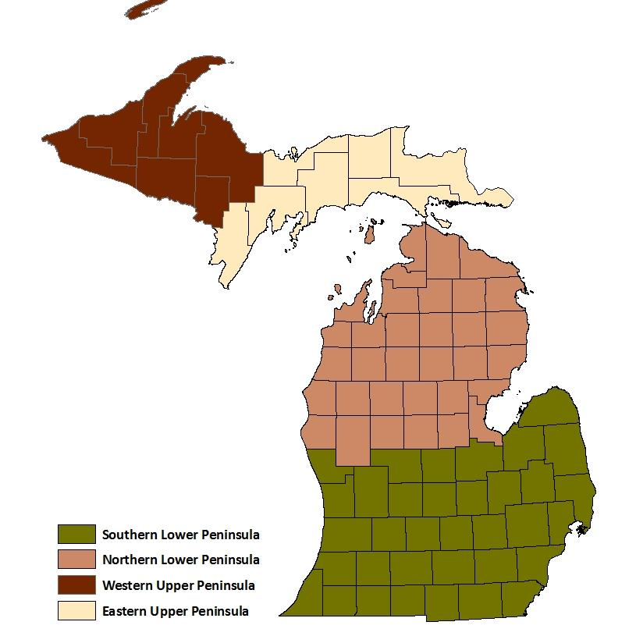
Michigan Map with Regions
N – denotes Northern
Lower Peninsula
S – denotes Southern
Lower Peninsula
E- denotes Eastern
Upper Peninsula
W – denotes Western
Upper Peninsula

Slide 7
Data Input Screens – Feedstock - Federal
Partial View of
Input screen in
Master Input
Tab in worksheet

Slide 8
Data Input Screens – Feedstock - State
Partial View of
Input screen in
Master Input
Tab in worksheet

Slide 9
Data Input Screens – Feedstock - Private
Partial View of
Input screen in
Master Input
Tab in worksheet

Slide 10
Data Input Screens - Feedstock

Slide 11
Data Input Screens –
Size and Conversion Rate
The size of plant in Million Gallons Per Year (MGY) and the
Conversion Rate in gallons per ton (gal/ton) can be modified
to arrive at different size plants and configurations.

Slide 12
Rectilinear Distance from Centroid
It is necessary to enter the rectilinear distance from the centroid
of the county supplying feedstock to the plant location. The cost,
energy, and emissions calculations are distance dependent.

Slide 13
Cost ($/Ton) Calculated Cells
The results are determined by the Master Input and the Distance
Matrix based on rectilinear distance.
Note: this example includes only the transportation cost.

Slide 14
Energy Intensity Calculated Cells
The results are determined by the Master Input and the Distance
Matrix based on rectilinear distance.
Note: this example includes only the yearly harvesting and transportation energy consumption.

Slide 15
GHG Emissions Calculated Cells
The results are determined by the Master Input and the Distance
Matrix based on rectilinear distance.
Note: this example includes only the yearly harvesting and transportation emissions.

Slide 16
Buttons to Execute Model
Once all the data is entered, depending on what you would like
to update in the Master, you will select the buttons in the
Master Input tab of the workbook.

Slide 17
Model Output
The output will show the Total and Average for each of the variables in the Model.
Note: this example includes only the yearly transportation cost.

Slide 18
Data Input Screens for Selected Multi Locations – Size and Conversion Rate
There are three multiple location configurations in the model.
This allows for a starting point to identify possible combinations.
Because of size
limitations in
Excel, the number
of changes that
could be accommodated
was limited.

Slide 19

Buttons to Execute Model
Once all the data is entered, you will select the button in the
Master Input tab of the workbook.
Because of size limitations, Excel will give you the following error:
Just click “Continue” button and the calculations will still execute and be accurate.

Slide 20
Model Output
This is the summary output for the Multiple Locations.
Note: this example includes only the yearly transportation cost.

Slide 21
Flexibility and Limitations
Flexibility
  Size of plant
    Example 50, 40, and 30
    Other sizes can be employed
  Changing data inputs for cost, emissions, and energy
Limitations
  Excel limits the number of iterations and changing cells
  Nine preselected locations

Slide 22
Acknowledgement and Disclaimer
This research was supported through an agreement with the Michigan Economic Development Corporation with funding from the U.S. Department of Energy award DE-EE-0000280. This report was prepared as an account of work sponsored by an agency of the United States Government. Neither the United States Government nor any agency thereof, nor any of their employees, makes any warranty, express or implied, or assumes any legal liability or responsibility for the accuracy, completeness, or usefulness of any information, apparatus, product, or process disclosed, or represents that its use would not infringe privately owned rights. Reference herein to any specific commercial product, or service by trade name, trademark, manufactured, or otherwise does not necessarily constitute or imply its endorsement, recommendation, or favoring by the United States Government or any agency thereof. The views and opinions of authors expressed herein do not necessarily state or reflect those of the United States Government or any agency thereof.

Slide 23
End of Tutorial
This is the end of the optimization tutorial.

